Slide 1
ACMA 231
Excel: Functions Part 2

Slide 2
Excel has hundreds of built-in functions that you can use in your calculations and data wrangling. You provide the name of the function and the required (and/or optional) inputs and Excel will run the code behind the scenes to provide your output.
Excel: Functions Part 2 ~ Functions
You will follow this structure:
NAME of FUNCTION (necessary input, [optional input])
You can also nest functions inside functions. For example, if you wanted to use a particular function to calculate an output that would be used as an input into another function, you could do it all in one step by nesting the functions:
NAME of FUNCTION (NAME of FUNCTION (necessary input, [optional input]), [optional input])
For example:
SUM (AVERAGE (D3:G3), AVERAGE (A3:C3))

Slide 3
What is the range of cells where your data lives for the lookup?
Excel: Functions Part 2 ~ VLOOKUP
What are you looking up?
VLOOKUP (lookup_value, table_array,
col_index_num, [range_lookup])
Column number of ranged data that you want to return when the lookup value is found for that row
Do you want an exact match or do you want Excel to guess?
Important: Remember that the lookup value should always be in the first column in the range for VLOOKUP to work correctly.

Slide 4
IF (logical test, [value if true], [value if false])
Excel: Functions Part 2 ~ IF
The requirement that leads to the THEN and ELSE steps
What happens if the logical test is true?
What happens if the logical test is false?
i.e.
If something is true, then do something, otherwise, do a different thing…
Nested IFs are frequently used.
For example, if something is true, then do something, otherwise, if something else is true, then do something, otherwise…
IF (logical test, [value if true], IF (logical test, [value if true], IF (logical test, [value if true], [value if false])))

Slide 5
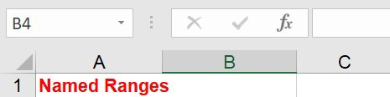
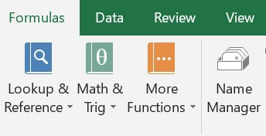
Excel: Functions Part 2 ~ Named Ranges
To make writing functions and referencing data sets in general easier, Excel allows you to name selected data ranges so that you don’t have to list the cell references every time they are used.
For example, if you have data in cells A1:G23, you can name the range “my_data” and simply refer to it by its name. Easy-peasy!
Two ways to name a range:
Highlight the region and enter the name in the Name Box located in the top left corner of the worksheet, just below the ribbon, and then press Enter
Go to the Formulas tab of the ribbon and click on Name Manager. Select New, name the range and define the range in the pop up. You can refer back to the Name Manager to update, add, or delete your named ranges.

Slide 6
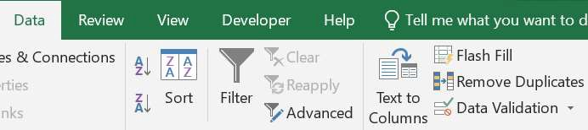
Excel: Functions Part 2 ~ Data Validation
Not sure why they call it Data Validation…
If you would like to use a dropdown to make things a bit easier for yourself and any user of your Excel file, follow the below. There are other really cool options with Data Validation as well.
Make a list of your desired selections somewhere within your workbook
Select the cell for which you would like a dropdown
On the Data tab of the ribbon, select Data Validation
Select List and put the range of cells where your desired selections live and then select OK

Slide 7
INDIRECT (ref_text, [a1])
Excel: Functions Part 2 ~ INDIRECT
The INDIRECT function allows you to use the contents of a cell as a reference, rather than the cell itself.
i.e. When used as a nested function, it can grab the contents of a cell and use it as an input into another function.
This can be particularly useful when referring to worksheet tab names, file names, and named ranges.

